Slide 1
1 Timothy 1
(English Standard Version)

Slide 2
1 Paul, an apostle of Christ Jesus by command of God our Saviour and of Christ Jesus our hope,
² To Timothy, my true child in the faith:
Grace, mercy, and peace from God the Father and Christ Jesus our Lord.

Slide 3
³ As I urged you when I was going to Macedonia, remain at Ephesus so that you may charge certain persons not to teach any different doctrine, ⁴ nor to devote themselves to myths and endless genealogies, which promote speculations rather than the stewardship from God that is by faith. ⁵ The aim of our charge is love that issues from a pure heart and a good conscience and a sincere faith. ⁶ Certain persons, by swerving from these, have wandered away into vain discussion, ⁷ desiring to be teachers of the law, without understanding either what they are saying or the things about which they make confident assertions.

Slide 4
⁸ Now we know that the law is good, if one uses it lawfully, ⁹ understanding this, that the law is not laid down for the just but for the lawless and disobedient, for the ungodly and sinners, for the unholy and profane, for those who strike their fathers and mothers, for murderers, ¹⁰ the sexually immoral, men who practice homosexuality, enslavers, liars, perjurers, and whatever else is contrary to sound doctrine, ¹¹ in accordance with the gospel of the glory of the blessed God with which I have been entrusted.

Slide 5
¹² I thank him who has given me strength, Christ Jesus our Lord, because he judged me faithful, appointing me to his service, ¹³ though formerly I was a blasphemer, persecutor, and insolent opponent. But I received mercy because I had acted ignorantly in unbelief, ¹⁴ and the grace of our Lord overflowed for me with the faith and love that are in Christ Jesus. ¹⁵ The saying is trustworthy and deserving of full acceptance, that Christ Jesus came into the world to save sinners, of whom I am the foremost. ¹⁶ But I received mercy for this reason, that in me, as the foremost, Jesus Christ might display his perfect patience as an example to those who were to believe in him for eternal life. ¹⁷ To the King of the ages, immortal, invisible, the only God, be honour and glory forever and ever. Amen.

Slide 6
¹⁸ This charge I entrust to you, Timothy, my child, in accordance with the prophecies previously made about you, that by them you may wage the good warfare, ¹⁹ holding faith and a good conscience. By rejecting this, some have made shipwreck of their faith, ²⁰ among whom are Hymenaeus and Alexander, whom I have handed over to Satan that they may learn not to blaspheme.

Slide 7
1 Timothy Introduction
The Pastoral Epistles:
1 Timothy
2 Timothy
Titus
No need to cover the foundational topics
i.e. Death and resurrection of Christ
Written to individuals who know the Gospel well
Timothy and Titus are Missionaries/Pastors
who worked with Paul

Slide 8
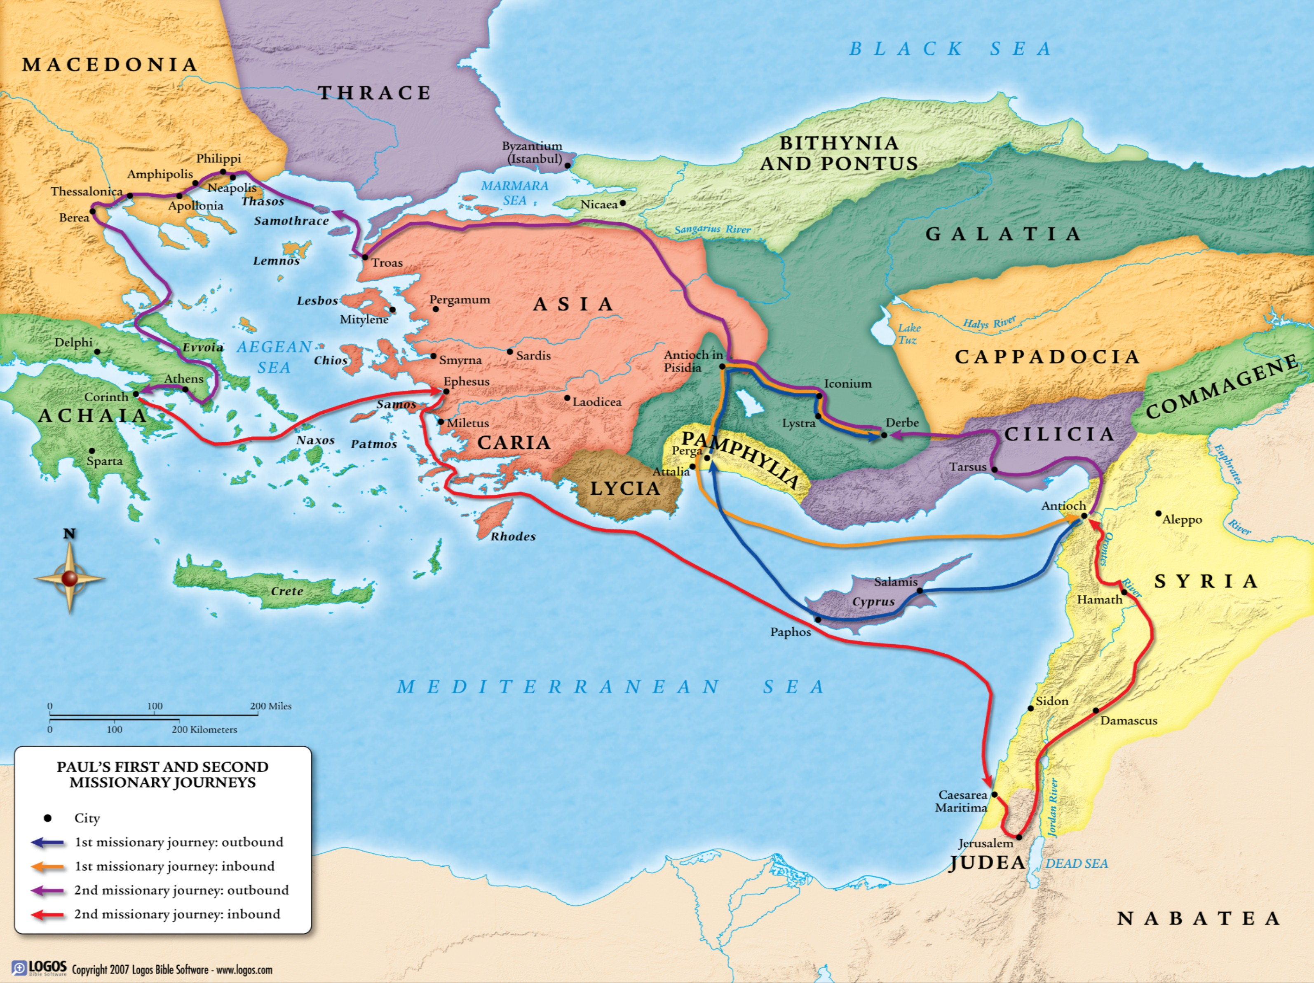
Ephesus
Lystra

Slide 9
1 Timothy Introduction
The Pastoral Epistles:
1 Timothy
2 Timothy
Titus
No need to cover the foundational topics
i.e. Death and resurrection of Christ
Written to individuals who know the Gospel well
Timothy and Titus are Missionaries/Pastors
who worked with Paul
Paul probably saw Timothy & Titus (& men like them), as the next generation to build on the work of the Apostles.
Timothy: A young man, called to exercise authoritative leadership in a church
A new age in the church. The Apostles had exercised authority.
Now passing on to Godly leaders.

Slide 10
Ephesus
Lystra

Slide 11
1 Timothy Introduction
The Pastoral Epistles:
1 Timothy
2 Timothy
Titus
No need to cover the foundational topics
i.e. Death and resurrection of Christ
Written to individuals who know the Gospel well
Timothy and Titus are Missionaries/Pastors
who worked with Paul
Timothy: A young man, called to exercise authoritative leadership in a church
The Apostles had exercised authority. Now passing on to Godly leaders.
⁵ The aim of our charge is love that issues from a pure heart and a good conscience and a sincere faith.
Ephesus – a common story:
Acts 18, 19, 20; Ephesians; Revelation 2
A Spiritual Battle
Needed to be reminded of the Gospel
Some of their own number would speak twisted things to lead people astray
^{Ephesians 6:(ESV)11} Put on the whole armour of God, that you may be able to stand against the schemes of the devil. ¹² For we do not wrestle against flesh and blood, but against the rulers, against the authorities, against the cosmic powers over this present darkness, against the spiritual forces of evil in the heavenly places.

Slide 12
1 Timothy Introduction
No need to cover the foundational topics
Written to individuals who know the Gospel well
Timothy: A young man, called to exercise authoritative leadership in a church
The Apostles had exercised authority. Now passing on to Godly leaders.
⁵ The aim of our charge is love that issues from a pure heart and a good conscience and a sincere faith.
Ephesus – a common story:
Acts 18, 19, 20; Ephesians; Revelation 2
A Spiritual Battle
Needed to be reminded of the Gospel
Some of their own number would speak twisted things to lead people astray
A Church in need of Love
Needed to learn to live in Unity
Timothy’s Role as a Pastor:
Lead by example;
Teach;
Rebuke;
Encourage;
Keep the church from Pointless Speculation
Develop Good order in the Church
With the aim of “Love”

Slide 13
1 Paul, an apostle of Christ Jesus by command of God our Saviour and of Christ Jesus our hope,
² To Timothy, my true child in the faith:
Grace, mercy, and peace from God the Father and Christ Jesus our Lord.

